Slide 1

IAIA Midterm Project 2024
IAIA Project #1
Drying Process RUL Estimation & Classification using ML
School of Mechanical and Control Engineering Jin Kwak(21900031)
Sunwoo Kim(22000090)
24.10.29
Industrial AI and Automation
Prof. Young-Keun Kim

Slide 2
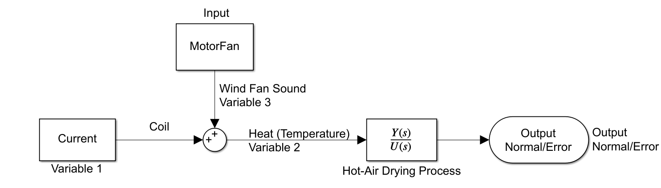
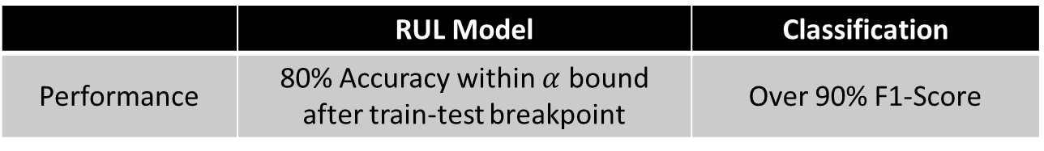
1. Introduction
Background
Hot-Air Drying Process stabilizes metal surface after plating and dries moisture from the product’s surface.
Generates hot air through coils and motor.
Problem
Errors throughout the process
→ Classification of 12 states(normal and 11 errors)
→ Prediction of Remaining Useful Life(RUL) of equipment
Goal of this project
Development of RUL model that analyzes RUL trend
Classification model for 12 states
Specific Goals
 | RUL Model | Classification
Performance | 80% Accuracy within $α$ bound after train-test breakpoint | Over 90% F1-Score

Slide 3
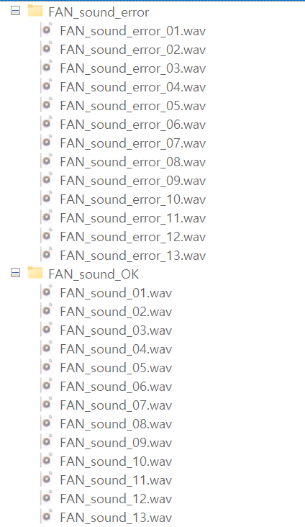
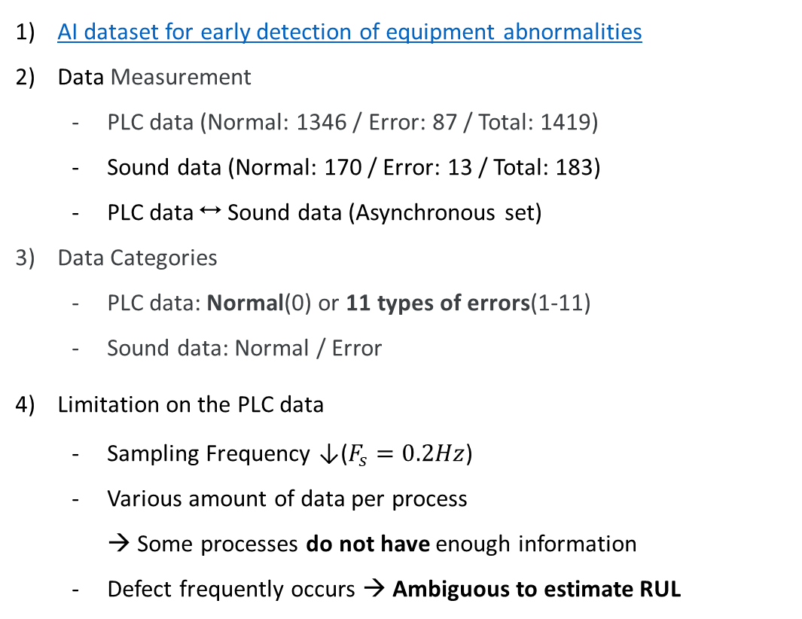
2. Dataset
AI dataset for early detection of equipment abnormalities
Data Measurement
PLC data (Normal: 1346 / Error: 87 / Total: 1419)
Sound data (Normal: 170 / Error: 13 / Total: 183)
PLC data ↔ Sound data (Asynchronous set)
Data Categories
PLC data: Normal(0) or 11 types of errors(1-11)
Sound data: Normal / Error
Limitation on the PLC data
Sampling Frequency ↓($F_{s}=0.2Hz$)
Various amount of data per process → Some processes do not have enough information
Defect frequently occurs → Ambiguous to estimate RUL
 | Attribute | Explain
Variables | Index | Auto-generated value when collecting data
 | Process | Tracking the process by assigning the same number to the same process
 | Time | Recording time down to seconds in the format (H:MM:SS)
 | Temp | Temperature within the hot-air drying system
 | Current | Current within the hot-air drying system
Label | 0-11 | Status Number

Slide 4
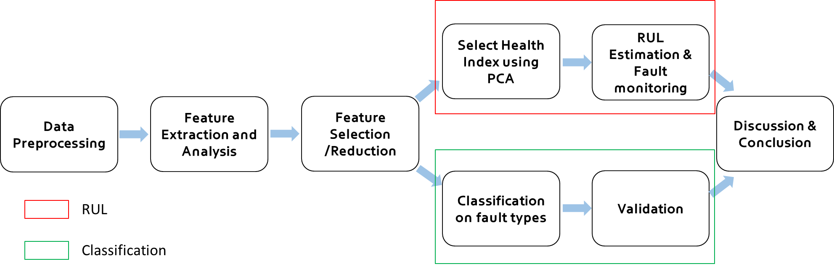
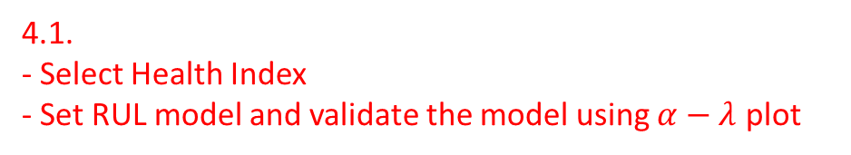
3. Methodology (1/2)
Strategy of the project
4.1.
- Select Health Index
- Set RUL model and validate the model using $α−λ$ plot
Divide dataset into each processes
Extract Time/Frequency-domain features
Select important features
5.
- Compare with other methods
- Performance analysis
4.2. - Set Classification models (SVM, KNN, Decision Tree)
- Draw Confusion matrix and compare performance

Slide 5
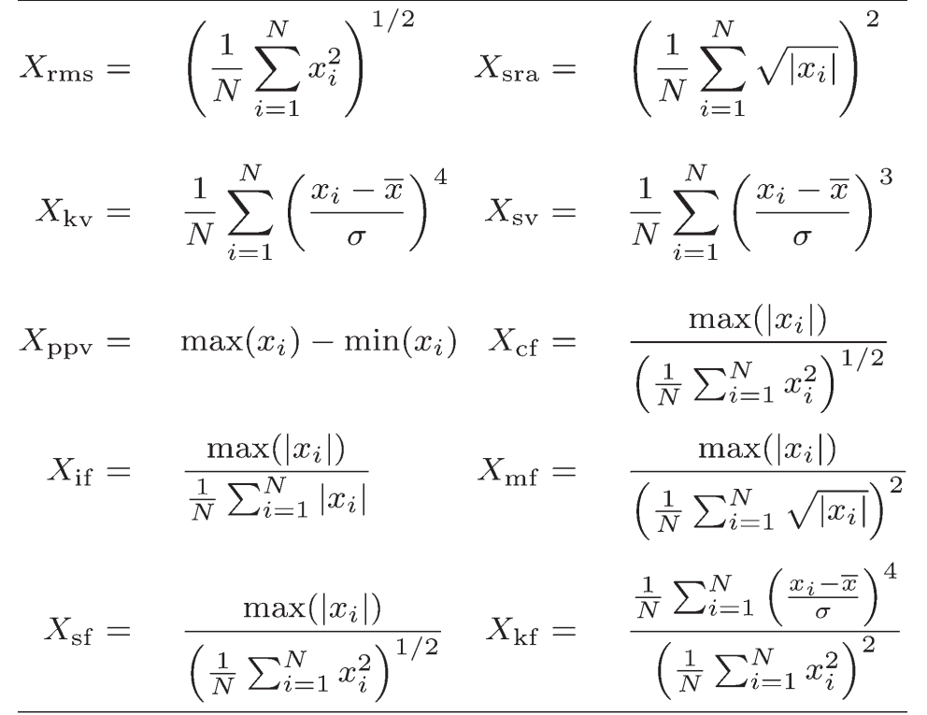
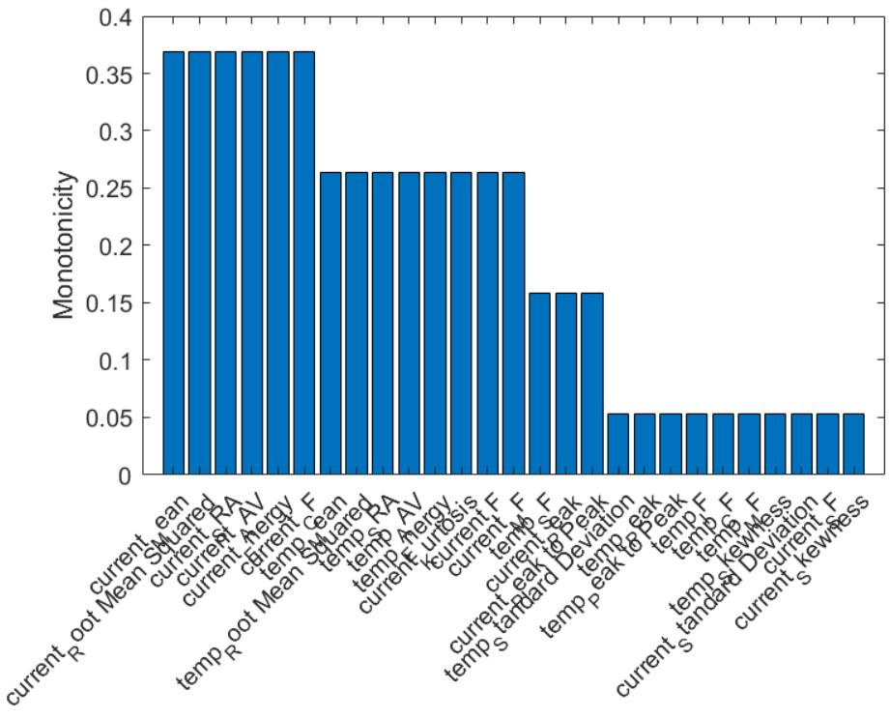
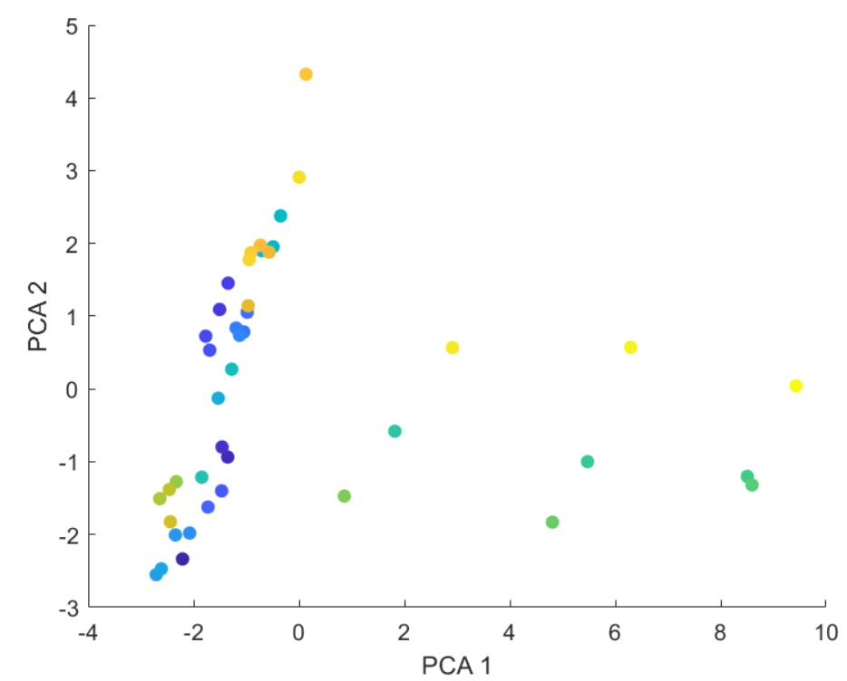
3. Methodology (2/2)
Time/ Frequency-domain based Feature extraction
Extract system Parameters & Statistical property of model parameters
Feature Selection/Reduction
Important technique to reduce dimensionality
Improve performance of parameters of the system
① Sequential Forward Selection
② Monotonicity
③ PCA
Notes:
보류

Slide 6
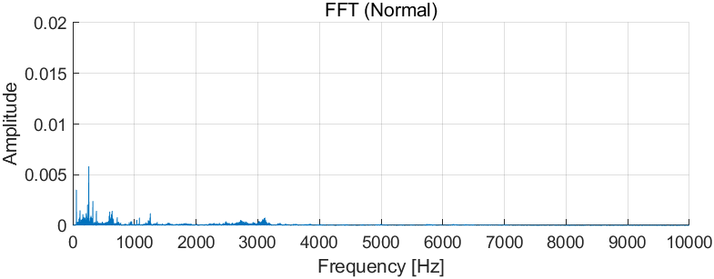
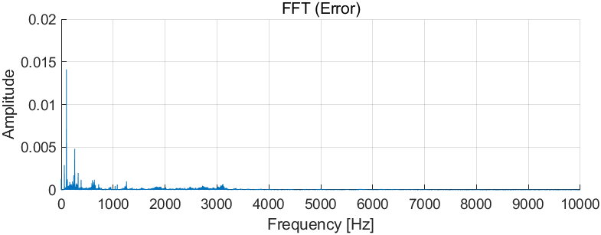
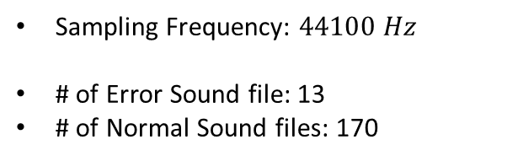
3.1. Classification (Sound Data)
3.1.1 Binary classification of two states (Normal/Error) using sound data
Binary Classification by sound data
Dataset
Sampling Frequency: $44100 Hz$
# of Error Sound file: 13
# of Normal Sound files: 170
Selection of Model
Logistic Regression is suitable for binary classification
Probability calculation using a logistic function

Slide 7
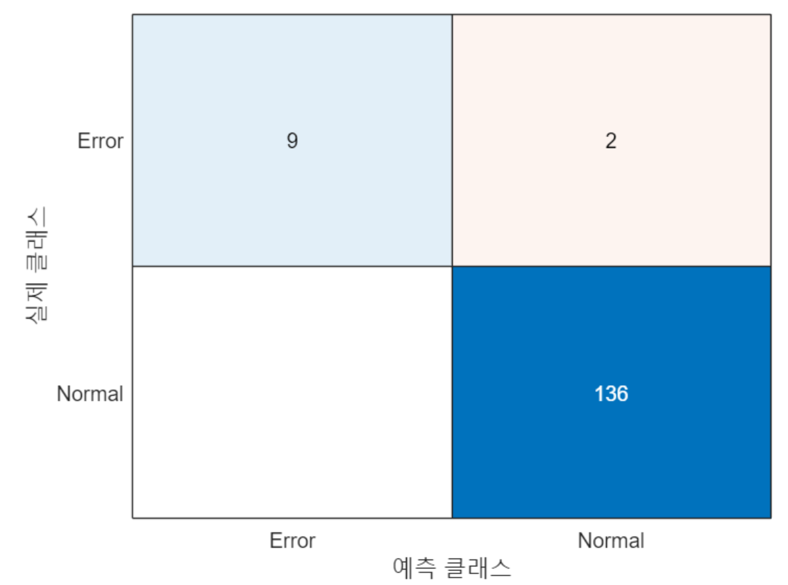
3.2. Classification Analysis
Sound Sensor Classification shows 95% of F1-Score
Through the binary classification, it good for classify the error & normal state obviously before multi-class classification.

Slide 8
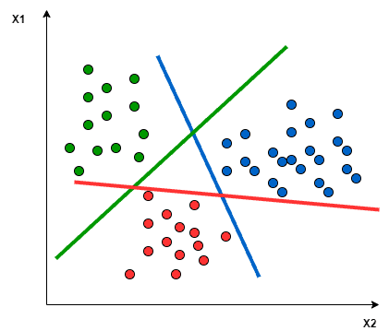
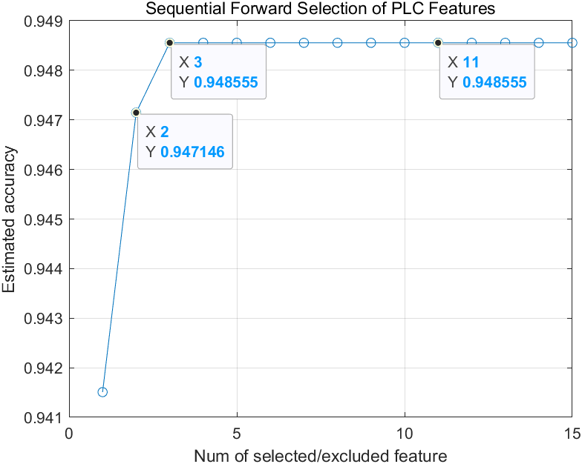
4.1. Classification (PLC Data) (1/3)
3.1.2 Multi-class classification of PLC data
Support vector machines (SVM)
∙ Model: Multi-class SVM model
∙ Dimension: 3
∙ Reason for the hyperparameter : Among the dimensions with the highest accuracy, select the lowest dimension(3).
Dimension ↑ Prone to Overfit ↑

Slide 9
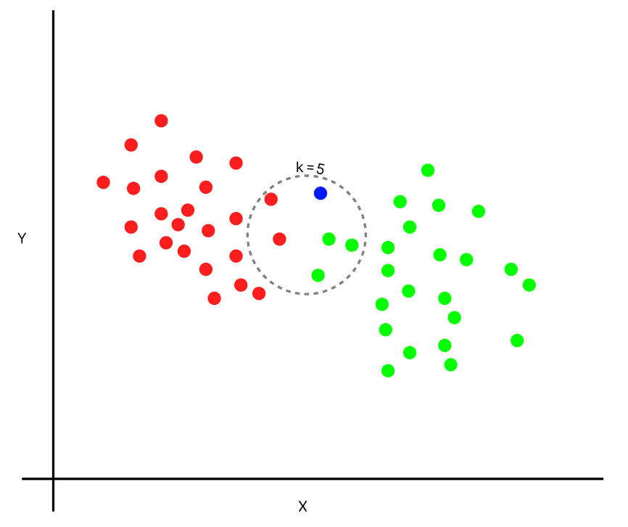
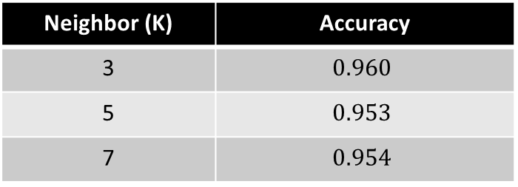
4.1. Classification (PLC Data) (2/3)
3.1.2 Multi-class classification of PLC data
2) K-Nearest Neighbor (KNN)
∙ Neighbor: 3
∙ Reason for the hyperparameter : Using quantitative approach, the number of neighbor(K) that has highest accuracy is 3
Neighbor (K) | Accuracy
3 | $$0.960$$
5 | $$0.953$$
7 | $$0.954$$

Slide 10
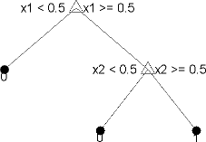
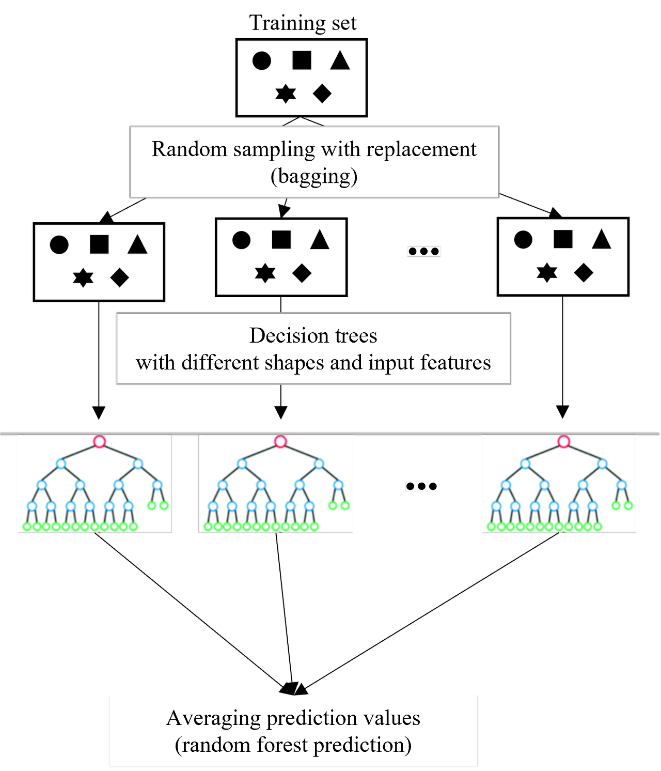
4.1. Classification (PLC Data) (3/3)
3.1.2 Multi-class classification of PLC data
3) Decision Tree
4) Random Forest
∙ Model: Random Forest
∙ Bagging decision tree: 50
∙ Reason for the hyperparameter :
The well performed number of decision tree by experiment.
∙ Model: Decision Tree
∙ Branch: 24
Tree | F1 Score
1 | 0.67
3 | 0.72
5 | 0.94
10 | 0.96
20 | 1

Slide 11
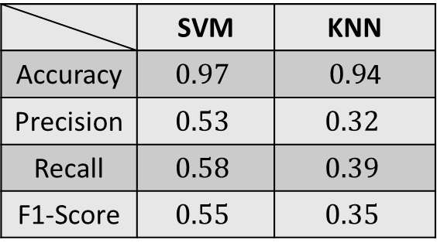
4.2. Classification Result (1/2)
Support vector machines (SVM)
2) K-Nearest Neighbor (KNN)
 | SVM | KNN
Accuracy | $$0.97$$ | $0.9$4
Precision | $$0.53$$ | $$0.32$$
Recall | $$0.58$$ | $$0.39$$
F1-Score | $$0.55$$ | $$0.35$$

Slide 12
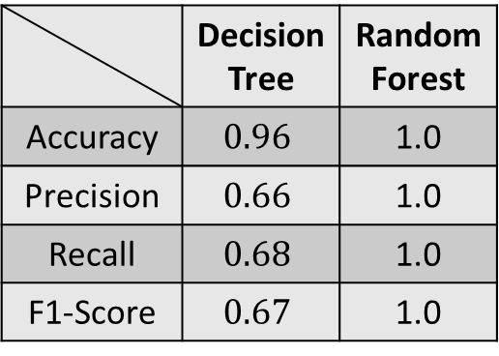
4.2. Classification Result (2/2)
3) Decision Tree
4) Random Forest (RF)
 | Decision Tree | RandomForest
Accuracy | $$0.96$$ | 1.0
Precision | $$0.66$$ | 1.0
Recall | $$0.68$$ | 1.0
F1-Score | $$0.67$$ | 1.0

Slide 13
4.3. Classification Analysis
Performance of Random Forest Models is best among 4 ML models. Random Forest Model achieved 100% F1-Score
Random Forest Model uses ensemble method, It combines multiple decision tree model and this prevents overfit.(Robust)
This data set has multiple classes, but not enough the number. In this case, multiple weak models for high accuracy as a result.

Slide 14
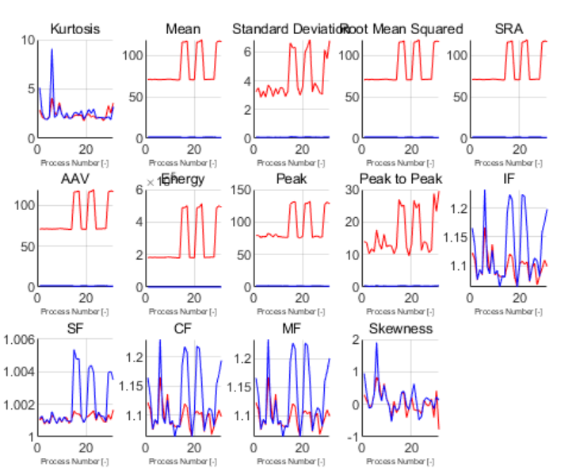
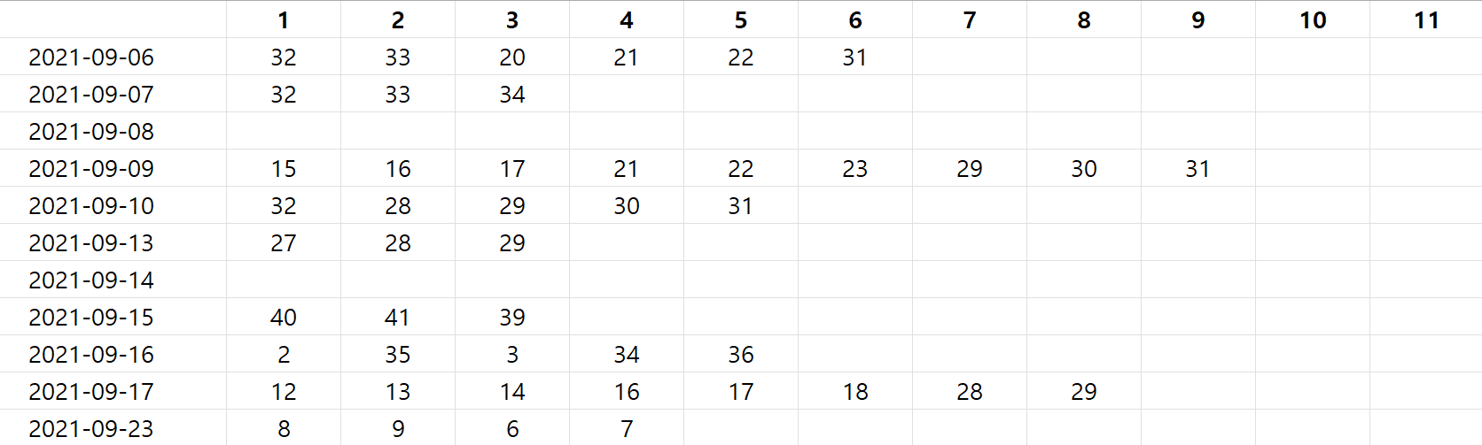
5.1. PHM (1/2)
Data with errors is selected and Time-domain features are extracted
Earliest process with error is selected as break-point Last process with error is assumed to be the end of useful life
Error Number
Temperature Current
Process Number

Slide 15
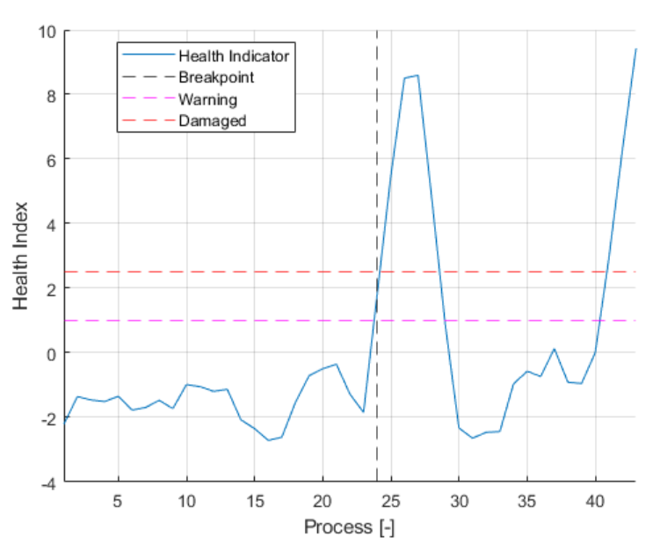
5.1. PHM (2/2)
Health Indicator is selected for RUL estimation
Indicator tends to increase until the end
Limitation: Processes with error shows peak values of health indicator which disturbs degradation model → Use Moving Average Filter for smoothing

Slide 16
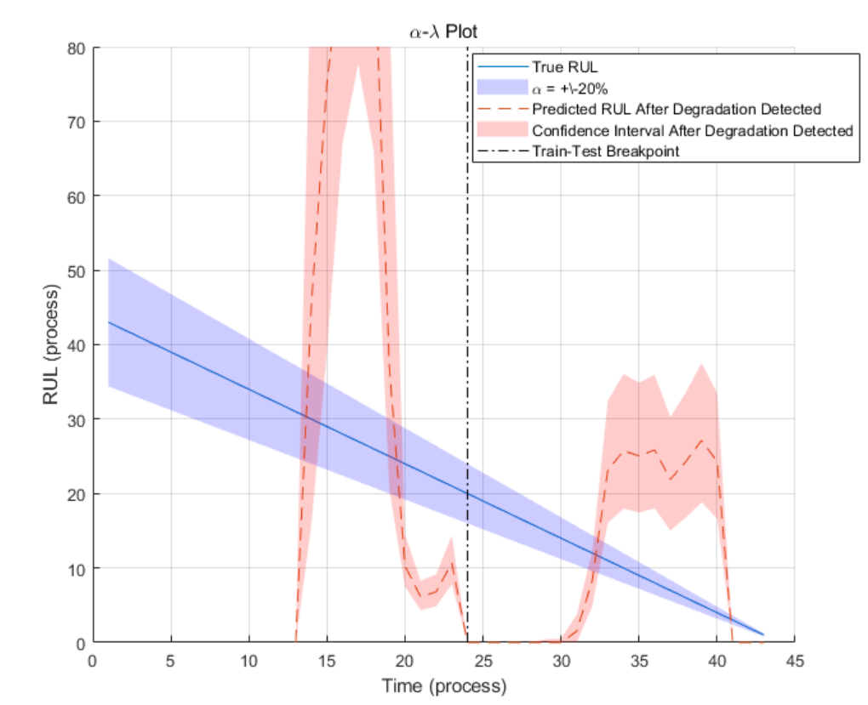
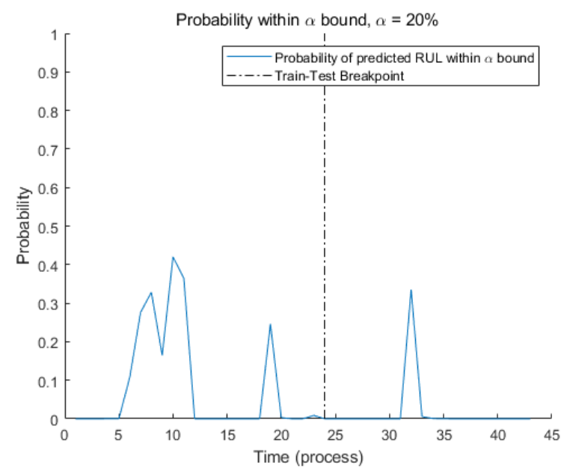


5.2. PHM Analysis
The $α−λ$ plot
$2) Probability of α$bound
→ $α$band overlaps by at maximum about 30%

Slide 17
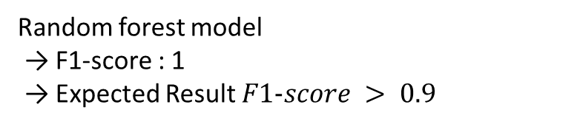
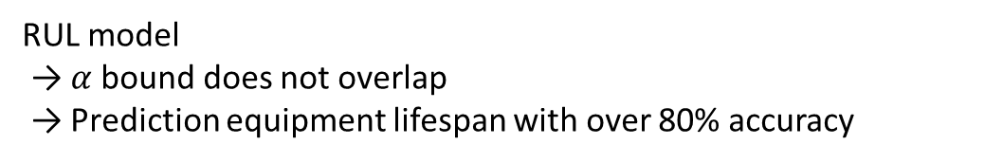
6. Result
Classification model
2) RUL model
Random forest model
→ F1-score : 1
→ Expected Result $F1−score > 0.9$
RUL model
→ $α$bound does not overlap
→ Prediction equipment lifespan with over 80% accuracy

Slide 18
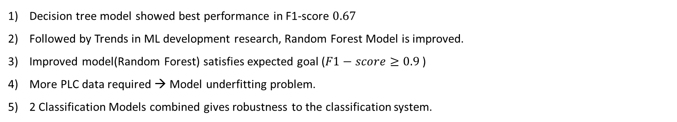
7. Conclusion
1. Classification model
Decision tree model showed best performance in F1-score $0.67$
Followed by Trends in ML development research, Random Forest Model is improved.
Improved model(Random Forest) satisfies expected goal ($F1−score≥0.9$)
More PLC data required → Model underfitting problem.
2 Classification Models combined gives robustness to the classification system.
2. RUL model
Did not meet the expected result from proposal
Sampling Time, Data size should be big enough for better performance

Slide 19
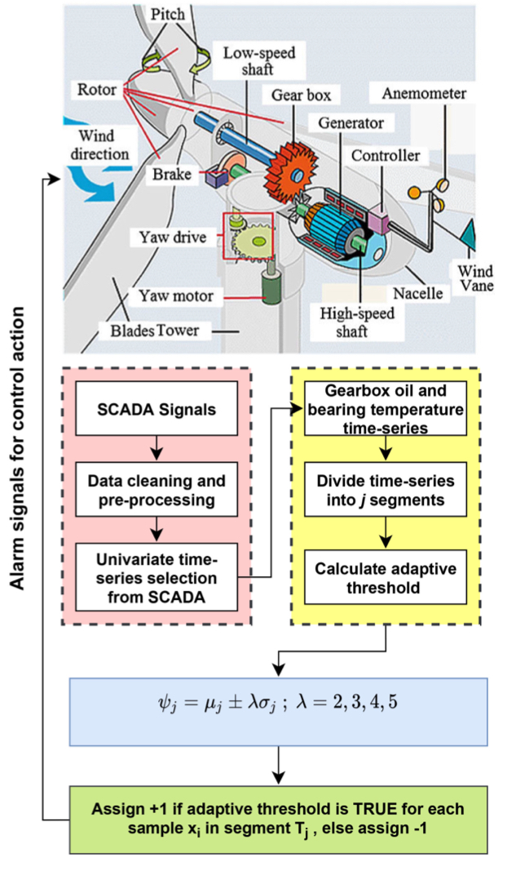
8. Paper Review (1/2)
Paper: Dhiman, H. S., Deb, D., Muyeen, S. M., & Kamwa, I. (2021). Wind turbine gearbox anomaly detection based on adaptive threshold and twin support vector machines. IEEE Transactions on Energy Conversion, 36(4), 3462-3469.
Background of the research
Reduce the cost of O&M in wind turbine system, condition monitoring is important.
Wind turbine shows error in the bearings(Rotary machine fault)
A condition monitoring (CM) system generally tracks the temporal behavior of variables in time-series such as wind speed, gearbox temperature, generator bearing temperature, nacelle temperature, and ambient temperature.

Slide 20
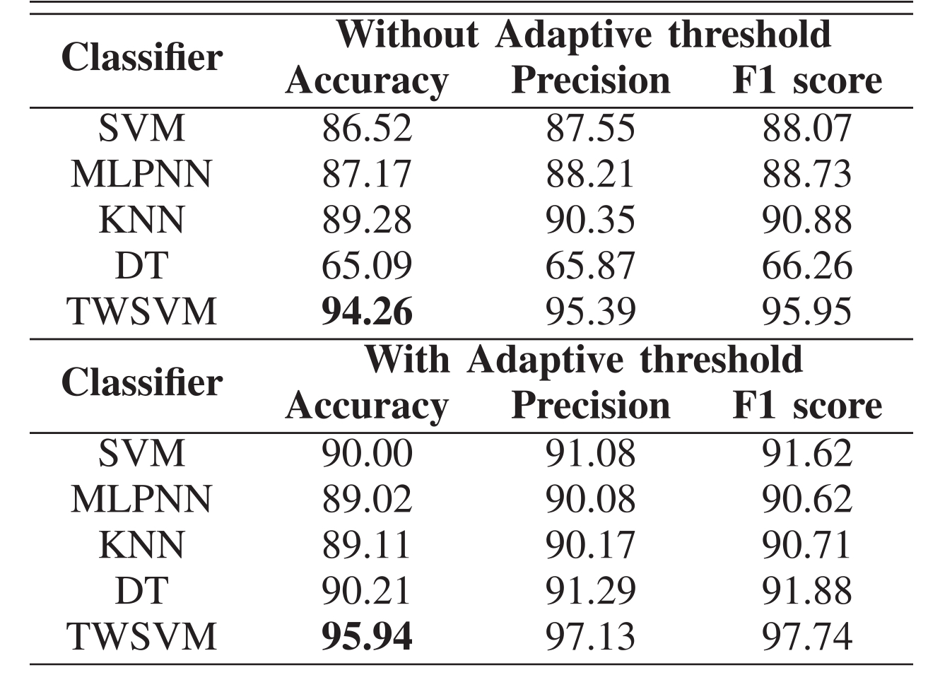
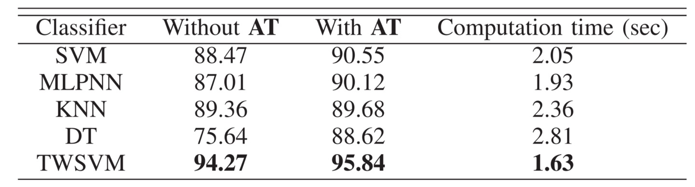
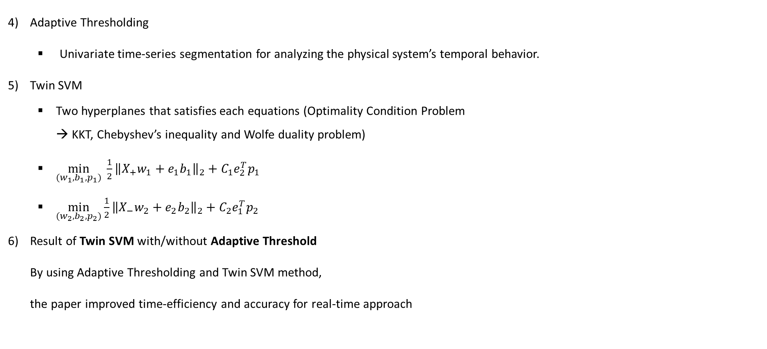
8. Paper Review (2/2)
Adaptive Thresholding
Univariate time-series segmentation for analyzing the physical system’s temporal behavior.
Twin SVM
Two hyperplanes that satisfies each equations (Optimality Condition Problem → KKT, Chebyshev’s inequality and Wolfe duality problem)
$\min_{(w_{1},b_{1},p_{1})}{\frac{1}{2}}{\left\|X_{+}w_{1}+e_{1}b_{1}\right\|}_{2}+C_{1}e_{2}^{T}p_{1}$
$\min_{(w_{2},b_{2},p_{2})}{\frac{1}{2}}{\left\|X_{−}w_{2}+e_{2}b_{2}\right\|}_{2}+C_{2}e_{1}^{T}p_{2}$
Result of Twin SVM with/without Adaptive Threshold By using Adaptive Thresholding and Twin SVM method, the paper improved time-efficiency and accuracy for real-time approach

Slide 21
9. Reference
[1] ㈜ KEMP, Innozinc 세라믹 아연도금, https://www.kampai.kr/
[2] Dhiman, H. S., Deb, D., Muyeen, S. M., & Kamwa, I. (2021). Wind turbine gearbox anomaly detection based on adaptive threshold and twin support vector machines. IEEE Transactions on Energy Conversion, 36(4), 3462-3469.

